Slide 1
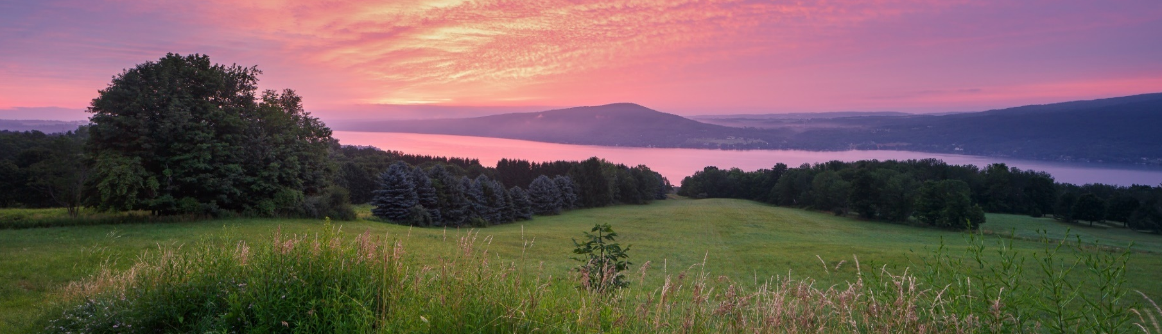
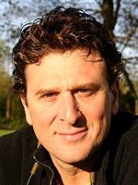
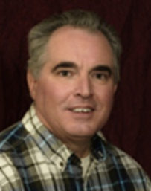





Healthy Lawns, Healthy Lake:
A Workshop for Lawn Care Professionals
With harmful algae blooms each summer, and concerns about increased aquatic plant growth- ongoing nutrient/pesticide loading from multiple land uses are of heightened concern. Canandaigua Lake watershed residents are looking for healthier lawn care alternatives to reduce their impact on the lake.
This free workshop, with lunch provided is offered to lawn care professionals and will provide practical strategies you can offer your customers that will reduce the amount of pesticides and fertilizers needed while maintaining a high quality lawn. Your customers are increasingly demanding this type of service.
Presentations by:
Frank Rossi “Grass Guy”
Event Details
Frank Rossi is an associate professor at
Cornell University in the School of Integrative Plant Science and is an Extension Turfgrass specialist. Frank will speak about practical solutions lawn care companies can use for their customers that balance Lawn and Lake Health
WHEN: Tuesday, February 11th 2020 12:00-3:00 PM - Lunch will be provided!
WHERE:
Canandaigua Public Works Department
205 Saltonstall Street Canandaigua, NY 14424
Please R.S.V.P. by February 4th to info@canandaigualakeassoc.org
Russ Welser
Russ is the Senior Resource Educator at
CCE and will speak about local experiences looking at both success and shortfalls in the lawn care industry when it comes to Integrated Pest Management
Event Sponsored by:
Learn more about CLWA www.canandaigualakeassoc.org

